Slide 1
TEACHER’S PERSONAL INFORMATION
Name: Nguyen Thanh Loan
Facebook: Loan Nguyễn Thanh
Mobile number: 0942 255 937
Email: loannguyenthanh1978@gmail.com

Slide 2
FINAL REVIEW – E3A

Slide 3
UNIT 7
 | Vocabulary | Grammar
1 | animals | Comparative (with intensifers)
2 | Fears and fobias | Equal comparison
 |  | Superlative
 |  | Ing-form
UNIT 8
1 | presentation, presentation equipment. | Indefinite Pronouns (something, everything, anything….)
2 |  | must, can’t for deduction
3 |  | make/let/help + somebody + do something
4 |  | Whose; possessive pronouns

Slide 4
UNIT 9
 | Vocabulary | Grammar
1 | the cost of living | VERBS+ -ING
2 | farming | present simple and past simple passive
3 | health | subject/object questions

Slide 5
Unit 7: DANGER
Lesson 1: What’s more dangerous?
GRAMMAR
Comparison: a little (more) / a lot (less)
We use much, a lot, far, a bit, a little, slightly before an adjective or adverb to emphasise the degree of comparison.
Quantifiers | Size of differences
much/far/a lot (Much is more formal than a lot.) Ex: Lemon is much sourer than a lime. | Large differences
slightly/a little/a bit (A little is more formal than a bit.) Ex: Orange is slightly juicier than a watermelon. | Small differences

Slide 6
GRAMMAR
Comparison: (not) as … as
Comparison: (not) as … as
1. We use as … as to show things are equal.
2. We use not as … as to show two things are unequal.mnv

Slide 7
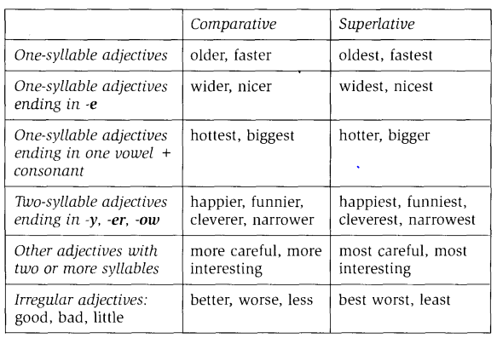
GRAMMAR
Comparatives and Superlatives

Slide 8
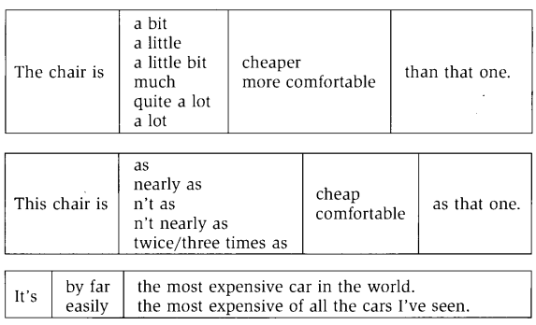

Slide 9
GRAMMAR
ING forms (Gerunds)
1. As the Subject of a sentence.
Ex: Speaking English in my English class is a problem for me.
2. As the Object of a sentence:
+ after verbs: like, love, enjoy, dislike, hate; can’t stand, try
Ex: She likes singing.
John isn't here. Try calling his home number.
+ prepositions: of, with, to, from…).
Ex: I am afraid of speaking English in my English class.
I am interested in watching horror films
I am bored with learning history.

Slide 10
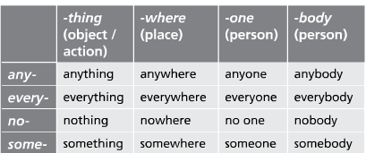
GRAMMAR
INDEFINITE PRONOUNS
Some books

Slide 11
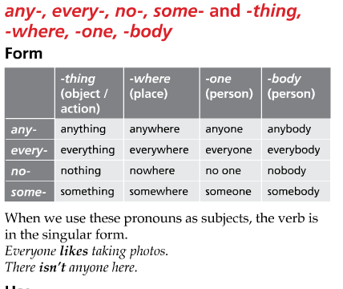
GRAMMAR

Slide 12
GRAMMAR
Make / let / help
Make / let / help + object + infinitive
Looking at the screen for a long time makes your eyes (become) worse.
Relaxing lets me refresh my mind.
Doing exercise helps me have a good shape.
My boss made me work overtime.
My father let me watch TV.

Slide 13
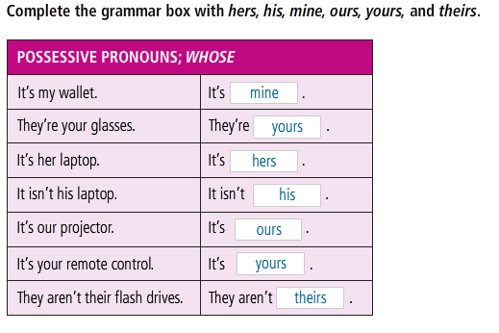
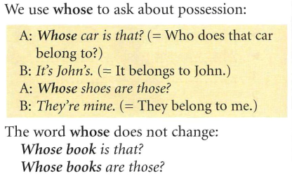
GRAMMAR
POSSESSIVE PRONOUNS
His car - John’s car – John’s
Her bag - Mary’s bag

Slide 15
GRAMMAR
Present simple passive
They keep chickens in very small cages.
Chickens are kept (by them)in very small cages.
Subject + to be + PII
Past simple passive
Not so long ago, they kept chickens for their eggs.
Not so long ago, chickens were kept for their eggs.
https://www.youtube.com/watch?v=nRGLDD0BBdc

Slide 16
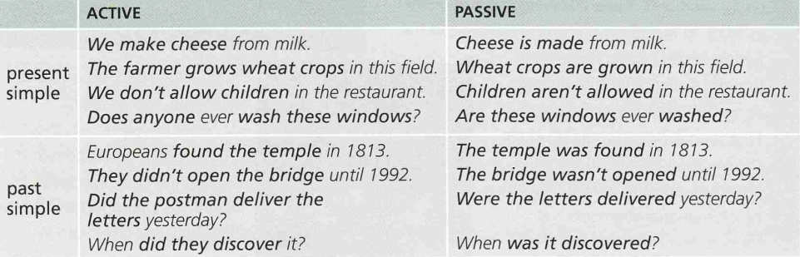
GRAMMAR
Present and past simple passive
https://www.youtube.com/watch?v=nRGLDD0BBdc

Slide 17
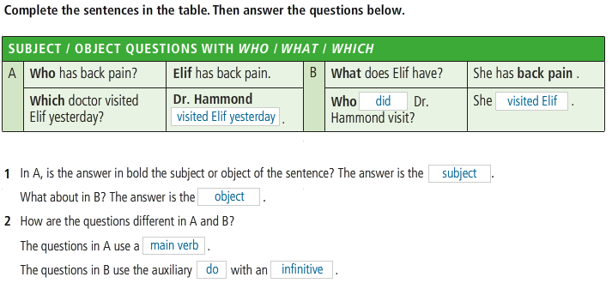
GRAMMAR

Slide 18
GRAMMAR
VERB+ -ING FORM
We use the “Verb + -ing form” after the following verbs:
 | Verbs | Examples
1 | begin | They began moving to this house in 1997.
2 | Enjoy | My sister enjoys watching horror films.
3 | Imagine | I can’t imagine living off the grid.
4 | Like | Do you like playing sports?
5 | Mean | If we want to catch the 7.30 train, that will mean leaving the house at 6.00
6 | Regret | I have always regretted not having studied harder at school.
7 | Spend | He spends two hours a day practicing English.
8 | Start | They started building the house in January.
9 | stop | I couldn't stop laughing.
10 | suggest | I suggested putting the matter to the committee.

Slide 19
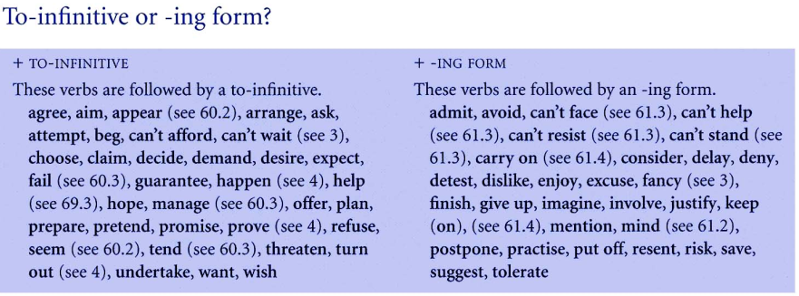
GRAMMAR
TO-INFINITIVE or -ING FORM

Slide 20
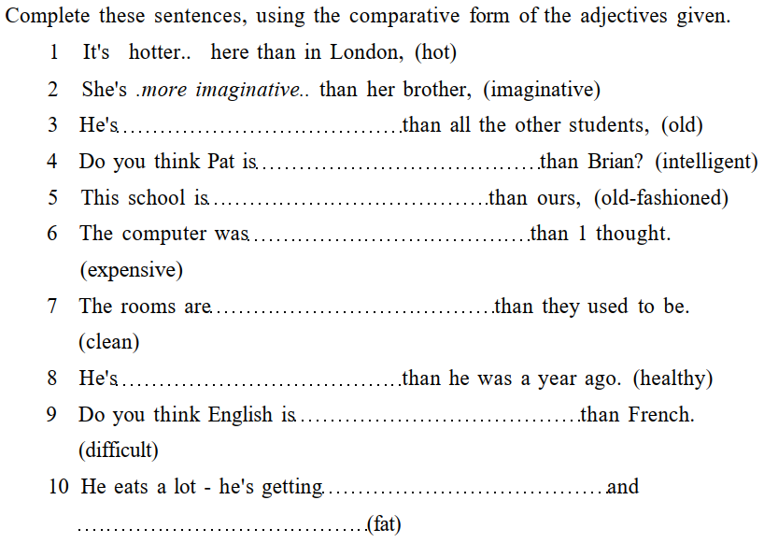
GRAMMAR
COMPARATIVE

Slide 21
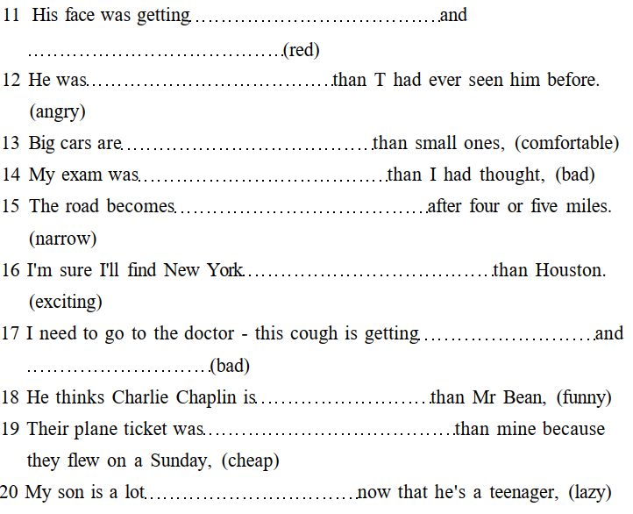
GRAMMAR
COMPARATIVE

Slide 22
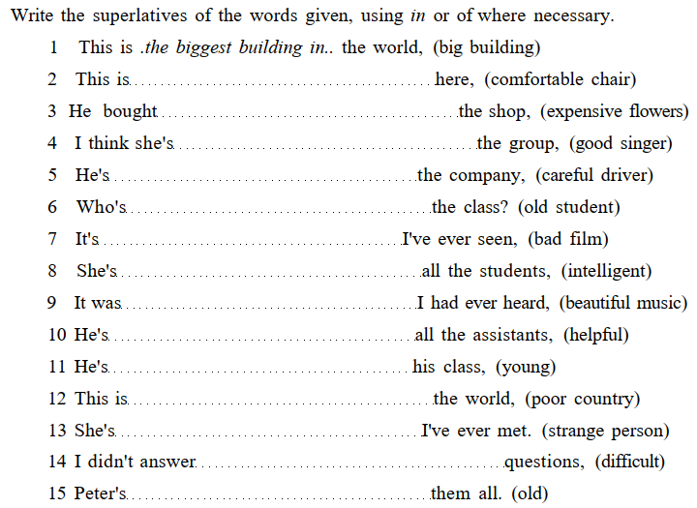
GRAMMAR
SUPERLATIVE

Slide 23
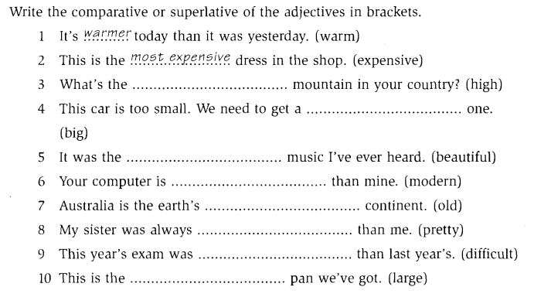
GRAMMAR
COMPARATIVE or SUPERLATIVE

Slide 24
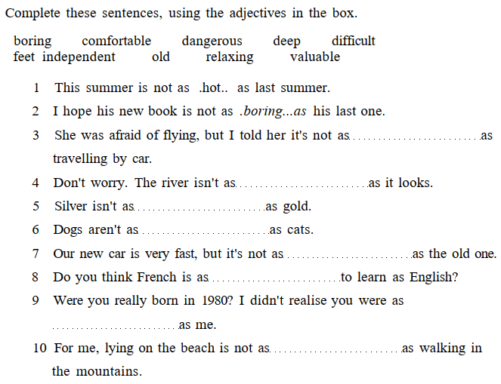
GRAMMAR
AS……..AS

Slide 25
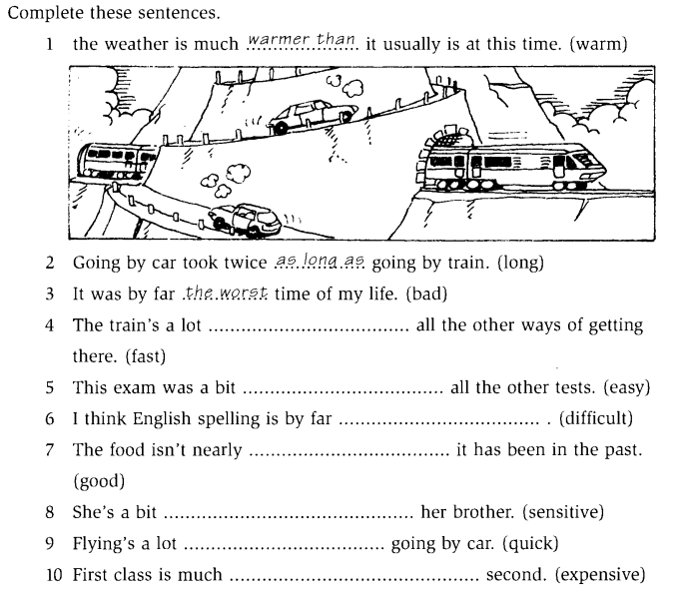
GRAMMAR
EQUAL COMPARISON,
COMPARATIVE or SUPERLATIVE

Slide 26
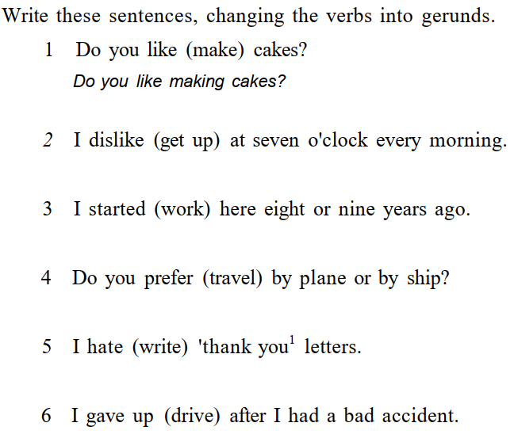
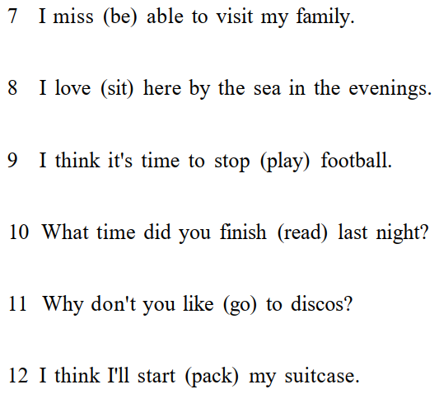
GRAMMAR
GERUNDS

Slide 27
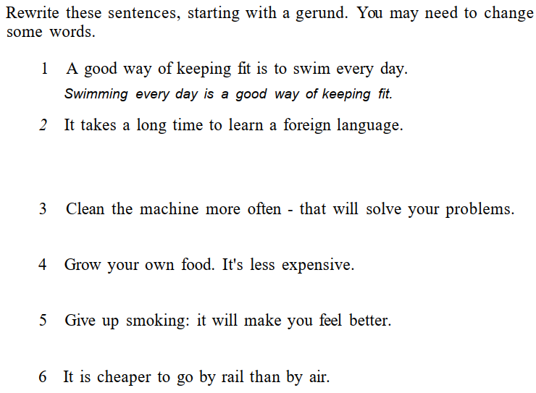
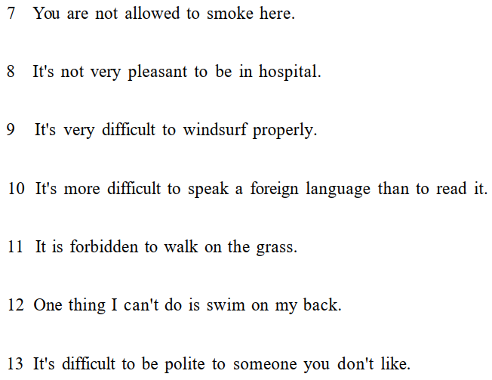
GRAMMAR
GERUNDS

Slide 28
GRAMMAR
INFINITIVES

Slide 29
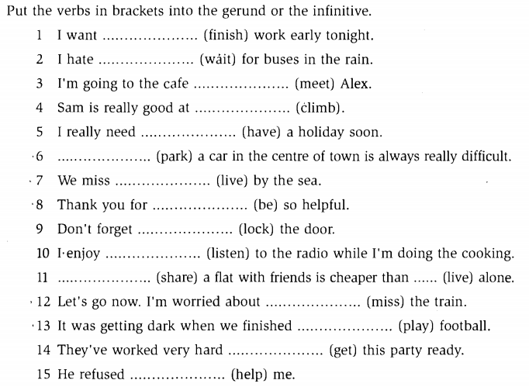
GRAMMAR
GERUNDS OR INFINITIVES

Slide 30
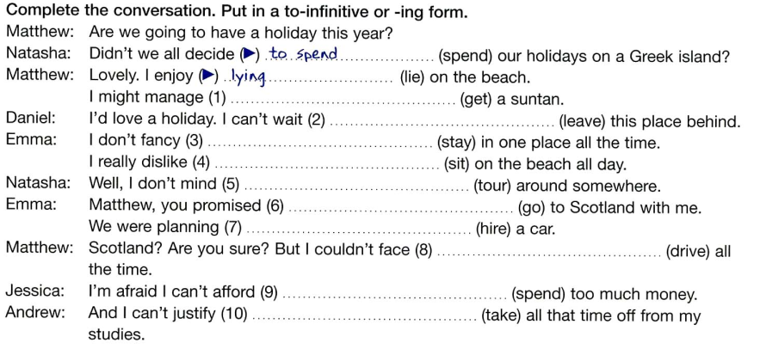
GRAMMAR
GERUNDS OR INFINITIVES

Slide 31
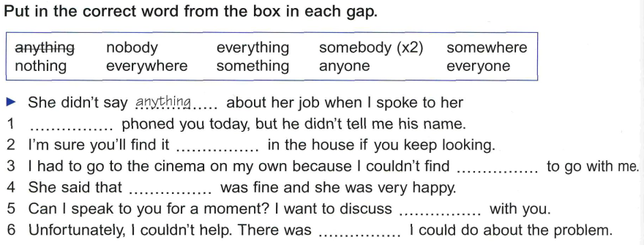

GRAMMAR
INDEFINITE PRONOUNS

Slide 32
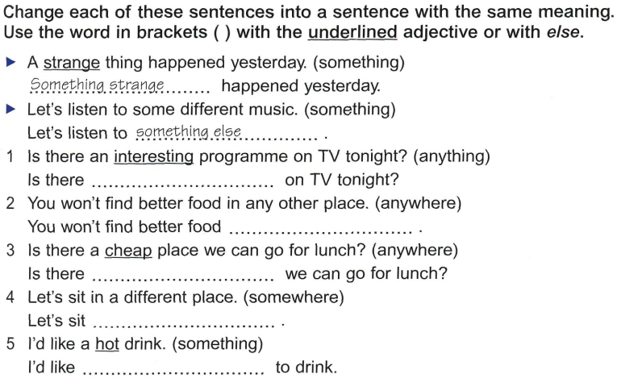
GRAMMAR
INDEFINITE PRONOUNS

Slide 33
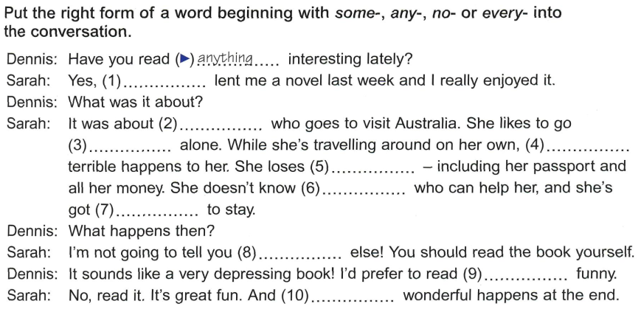
GRAMMAR
INDEFINITE PRONOUNS

Slide 34
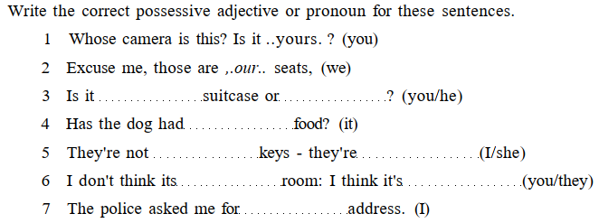
GRAMMAR
POSSESSIVE ADJECTIVES
or POSSESSIVE PRONOUNS

Slide 35
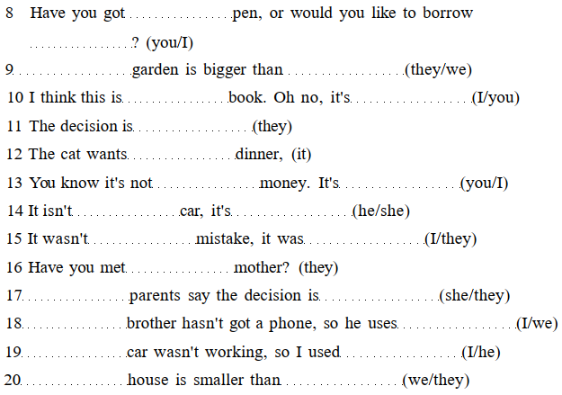
GRAMMAR
POSSESSIVE ADJECTIVES
or POSSESSIVE PRONOUNS

Slide 36
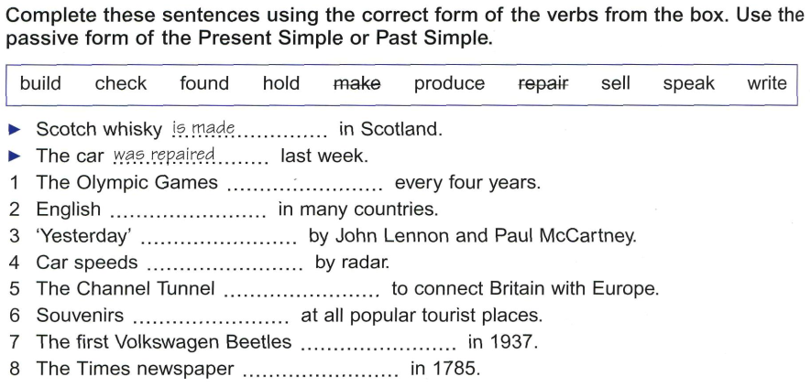
GRAMMAR
PASSIVE SENTENCES

Slide 37
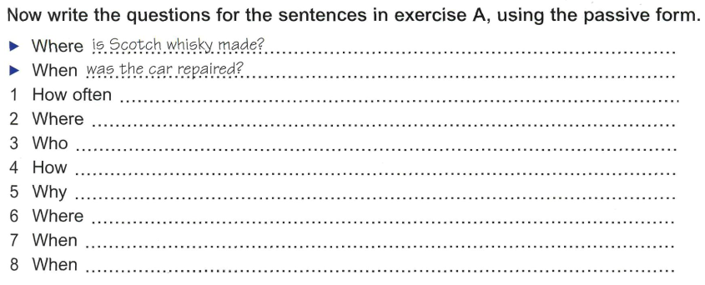
GRAMMAR
PASSIVE SENTENCES

Slide 38
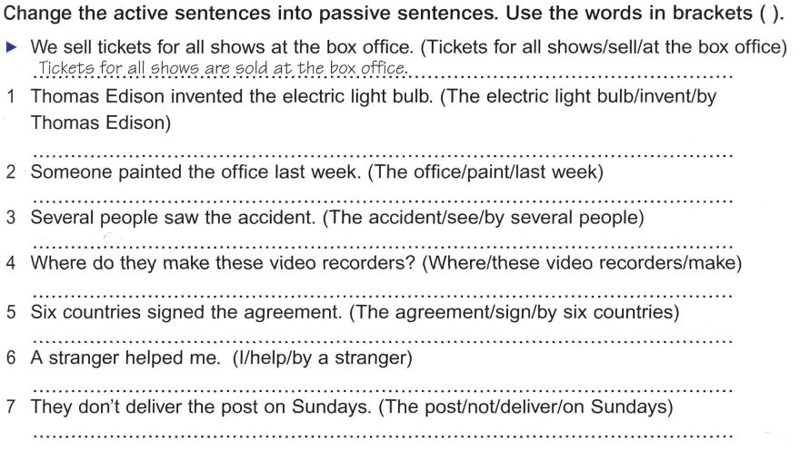
GRAMMAR
PASSIVE SENTENCES

Slide 39
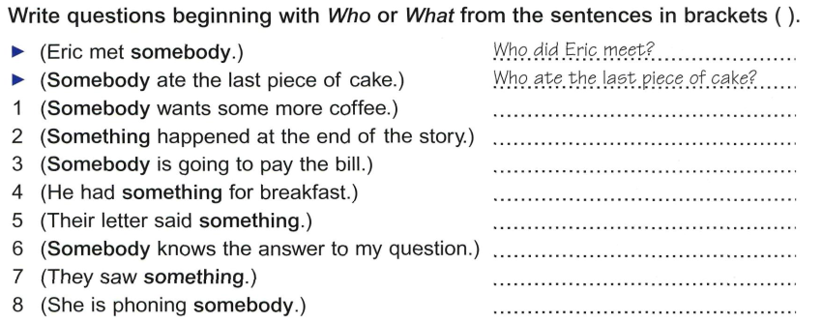
GRAMMAR
SUBJECT and OBJECT QUESTIONS

Slide 40
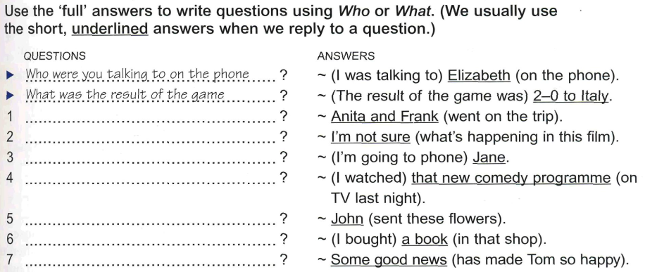
GRAMMAR
SUBJECT and OBJECT QUESTIONS

